Slide 1
Crowd Funding Project- PowerBI Dashboard

Slide 2
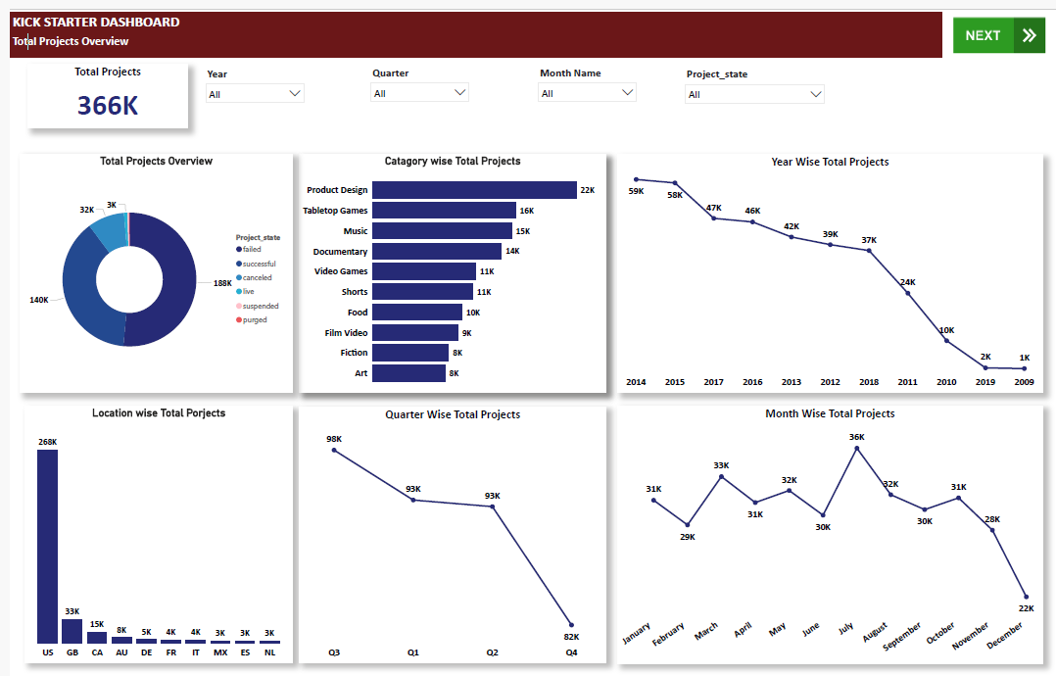

Slide 3
